Slide 1
My favorite books

Slide 2
Books in history!
Reading has been an effective tool to discover the life for many centuries. Books can be your guide to living, can develop your understanding of the world around and are also one of the most popular leisure time activities of all.

Slide 3
Whoa!
As for me, I discovered the wonderful world of reading when I was 13. I had read several books before but the book I was presented for my 13 birthday changed my attitude to reading and I started doing it for pleasure. I still remember this story in all details and treat it as my favorite one.

Slide 4
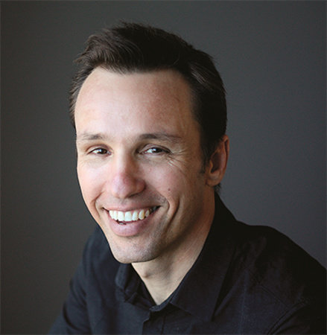
Marcus Zusak
Markus Zusak was born in 1975 in Sydney, Australia, the youngest of four children of immigrant German and Austrian parents. Neither parent could read or write English when they first arrived in Australia, but they wanted their children to master the language and strongly encouraged them to read and communicate in English from an early age. Zusak began writing fiction at age 16 and pursued a degree in teaching.

Slide 5

The Book Thief
The Book Thief followed in 2006 and was met with even more critical and popular success. A sympathetically drawn Death narrates the story of orphan Liesel Meminger, who finds friendship and a new family in a small town in Germany during World War II. She also discovers the power of words and books as Hitler’s Nazi agenda threatens to destroy everything she has come to love. Zusak chose the subject matter in part to share the stories his parents told him about growing up in Austria and Germany during the war.

Slide 6
Liesel Meminger
The Book Thief was published as a novel for adults in Australia and as a young adult novel in the United States, but Zusak doesn’t draw such distinctions. “What I wanted to do… was write someone’s favorite book,” rather than write for a specific audience, Zusak revealed in an interview. Author John Green reviewed the book in the New York Times, hailing it as “brilliant” and “achingly sad,” and said of the heroine, “the hope we see in Liesel is unassailable, the kind you can hang on to in the midst of poverty and war and violence.”

Slide 7
Excerpt from the book
ПРОЛОГ
ГОРНЫЙ ХРЕБЕТ ИЗ БИТОГО КАМНЯ
где наш рассказчик представляет:
себя — краски — и книжную воришку
СМЕРТЬ И ШОКОЛАД
Сначала краски.
Потом люди.
Так я обычно вижу мир.
Или, по крайней мере, пытаюсь.
* * * ВОТ МАЛЕНЬКИЙ ФАКТ * * *
Когда-нибудь вы умрете.
PROLOGUE
A mountain range of rubble
in which our narrator introduces.
himself—the colors—and the book thief
DEATH AND CHOCOLATE
First the colors.
Then the humans.
That’s usually how I see things.
Or at least, how I try.
You are going to die.

Slide 8

Thank you for attention

